Slide 1
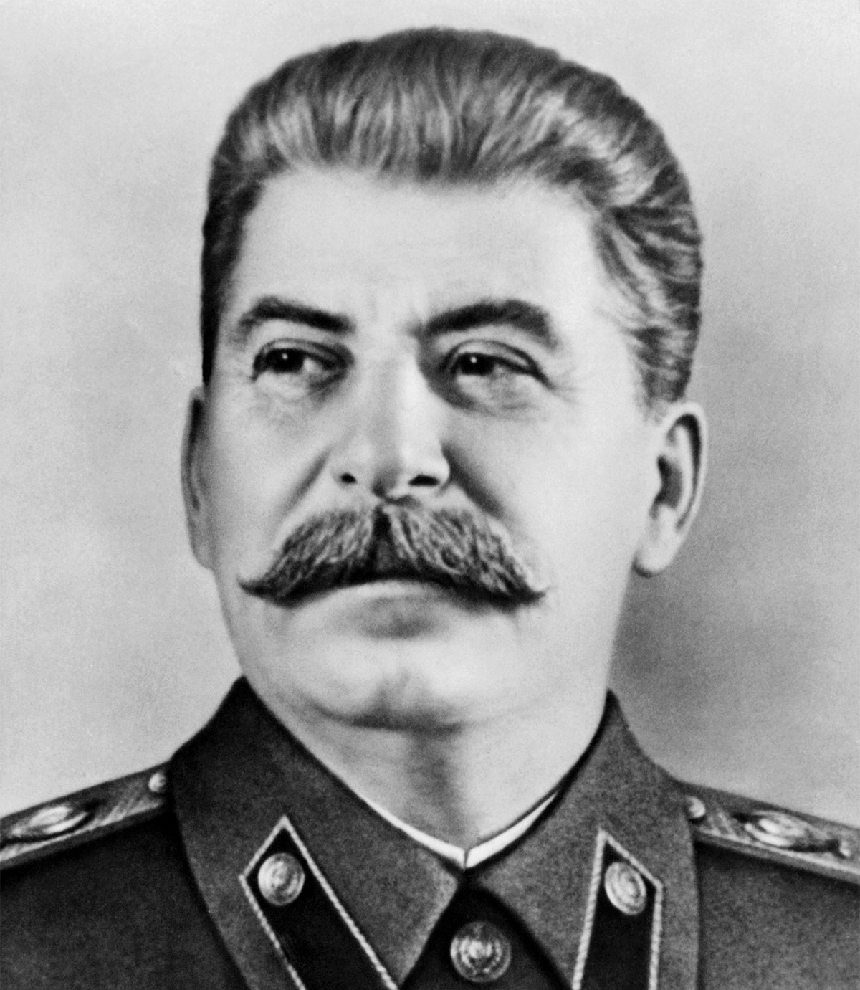
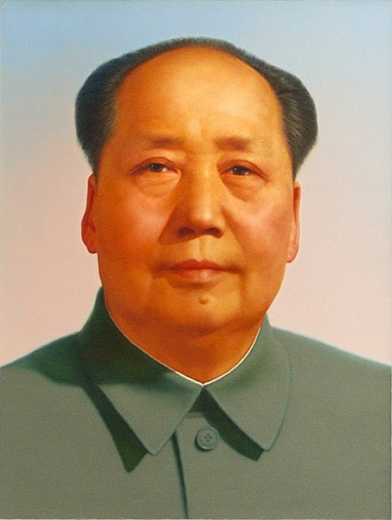
The Cults Of Personality
Of Joseph Stalin & Mao Zedong
As Perpetuated Through Visual Propaganda
By William Hafey

Slide 2
Topics/Points of Interest
Ideology
Hegemonic Response
Socialist Realism

Slide 3
The Ideology
An emerging communist ideology within a country is a sign of its citizens desiring change.
Communist ideology emcompasses power to workers, the proletariat (or people whose only worth is their own labor), peasants and to create opposition to the present or past regime.
The Ideology in itself is meant to empower a nation, it is its own form of nationalism with a plan/idea that topples a regime rather than just overthrowing a single leader.
Peasants and the proletariat become persuaded to support a new government in which theoretically everyone benefits equally regardless of the difference of skills, jobs or the worth of a specific labor.

Slide 4
The Hegemonic Response
The use of propaganda or threats to create resulting Dominant and Counter-Hegemonic responses in Soviet and Communist/Socialist regimes is used to sway current opposition or keep itself in power.
Dominant and Counter-Hegemonic reactions usually pair hand-in-hand in this presentation as I explain them through the presentation.
Propaganda before a non-communist regime is toppled tends to mostly be Counter-Hegemonic to the status quo (Monarchy or Capitalist society).
Propaganda after the communist regime is installed tends to mostly be Dominant Hegemonic to support the government (Positive, Nationalistic).
This type of propaganda is extensively used to support the individual leader, rather than the whole of the Communist government.

Slide 5
Socialist Realism
Encompasses Art, film, literature and state-run media that ties and strengthens ideology and hegemonic responses together.
Illustrates what is ideal but not seen in a real Communist society.
Takes on the themes of family, supporting the individual leader of the government, deifying the leader, praising the proletariat, military and the youth.
All of this also encompasses nationalism, the idea of making your country better with change and supporting that change.
Socialist Realism art can only exist in a present Communist society, in order to do away with the past and create new artificial history/facts.

Slide 6
Background of Russian Revolution Era Art
Loss of Russo-Japanese War and the losses and prolonged length of World War I created Anti-Tsarism.
Anti-Tsarism created Russian Revolution of 1905 which created a Parliament and political parties, including the Social Democratic Labor Party (Bolsheviks).
Between 1905 and 1917 at the start of the second Russian Revolution, much of the propaganda of the Bolsheviks was Counter-hegemonic against the monarchy.

Slide 7
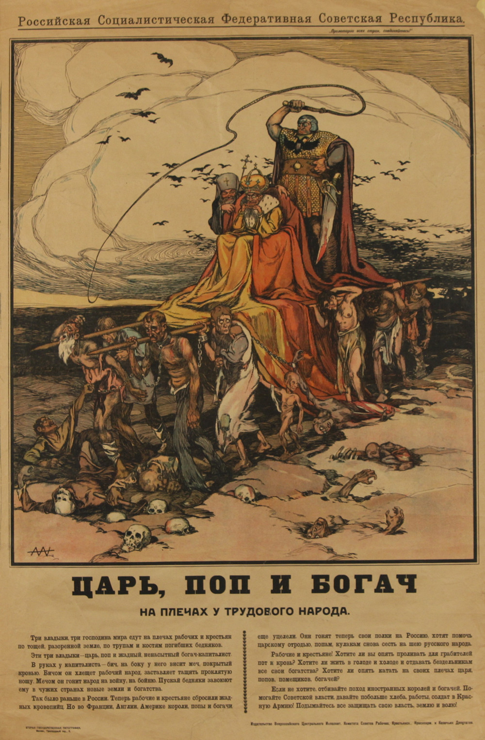
Alexander Apsit.
Tsar, Pope, and the Rich on the Worker's Shoulders
Workers, peasants and the proletariat carrying the Tsar, Pope and Rich while being whipped.
Collapsed, dirty, tired, in rags, dead upon their feet.
Counter hegemonic to the Tsar. Meant to sow discontent.

Slide 8
Stalin’s Cult of Personality Propaganda
To jump ahead...
Characterized by attacking remnants of anti-Communist, Capitalist forces/free-thinkers or well-off peasants remaining in Soviet Union.
Paints an illusion of the ideal Soviet life.
Nationalistic, militaristic, especially during World War II.
Illustrates positive values and characteristics of Joseph Stalin, especially in the sense of worship or believing Stalin to be the “Father of Nations.”
Many images portray Stalin with children as part of him being a father figure and “kind, sensitive” leader.
Propaganda so successful that outside Western audiences called him, “Uncle Joe”.

Slide 9
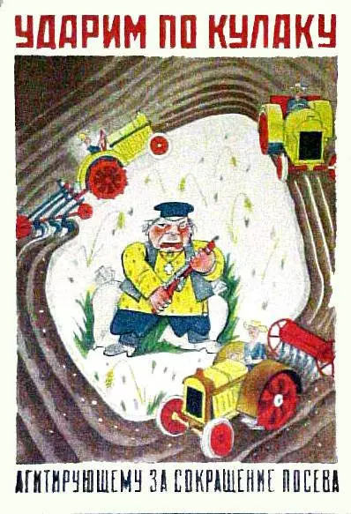
State Media, Let Us Strike at the Kulaks Who Are Agitating For the Reduction of Sowing
During the time of Collectivization which was a collective agriculture plan that still created famine
Stalin wanted to eliminate the well-off kulaks who kept more grain for themselves
Characterized them as greedy, stubborn who hurt the prosperity of the rest of the nation

Slide 10
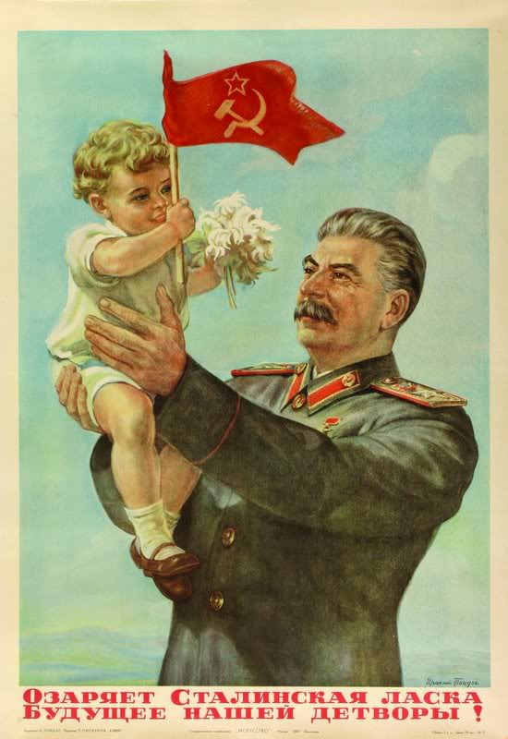
Various Artworks of Stalin with Youth
Further cemented Stalin’s appeal as the “Father” and made him look sensitive to Russia’s future populace
Prime examples of Socialist Realism
Iraklii Toidze, Stalin’s kindness illuminates the future of our children! 1947

Slide 11
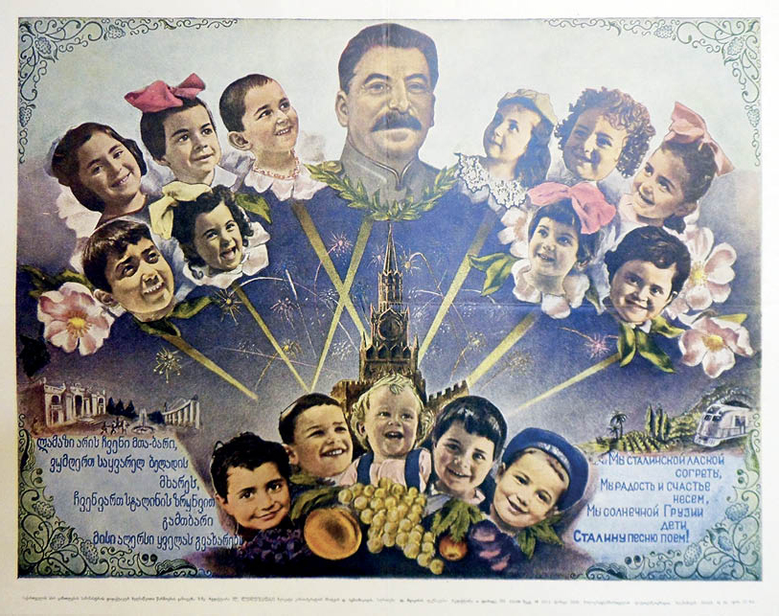
Various Artworks of Stalin with Youth
Further cemented Stalin’s appeal as the “Father” and made him look sensitive to Russia’s future populace
Prime examples of Socialist Realism
We are warmed by Stalin’s affection, Unknown, 1949

Slide 12
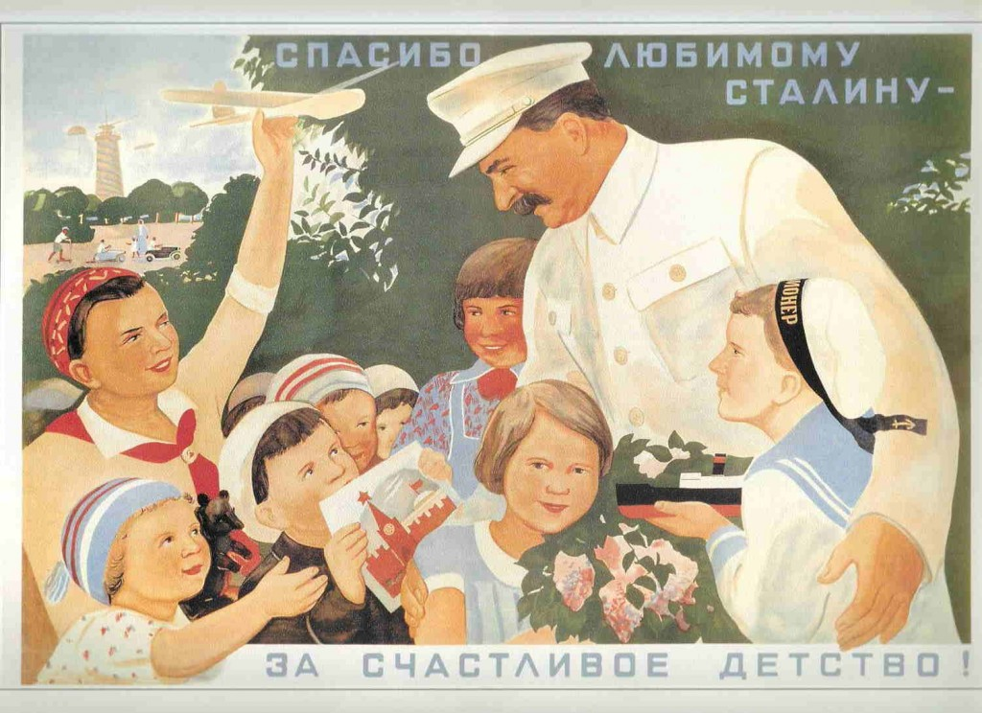
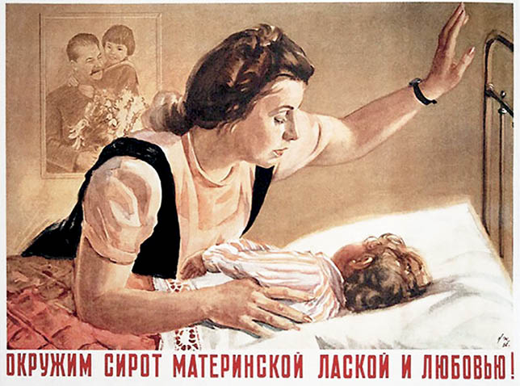
Various Artworks of Stalin with Youth
Further cemented Stalin’s appeal as the “Father” and made him look sensitive to Russia’s future populace
Prime examples of Socialist Realism
‘Thank you beloved Stalin for our happy childhood’, Viktor Govorkov, 1936
‘We’ll surround orphans with maternal kindness and love’, Nikolai Zhukov, 1947

Slide 13
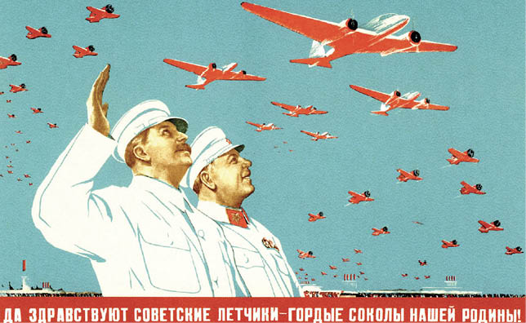
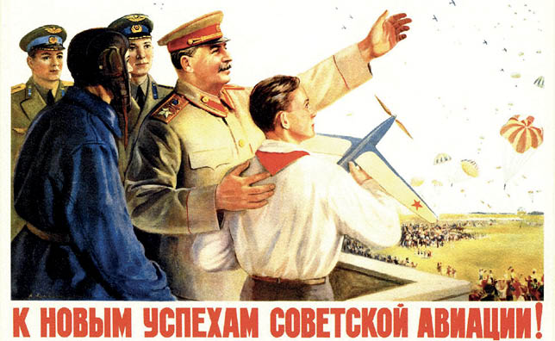
Various Artworks of Stalin and Military
Military, peace, prosperity under Stalin
Used extensively during and after World War II to boost morale
‘Long live the Soviet pilots — the proud falcons of our motherland!’, Nina Vatolina & Nikolai Denisov, 1938
‘To the new achievements of Soviet aviation!’, Vladislav Pravdin, 1950

Slide 14
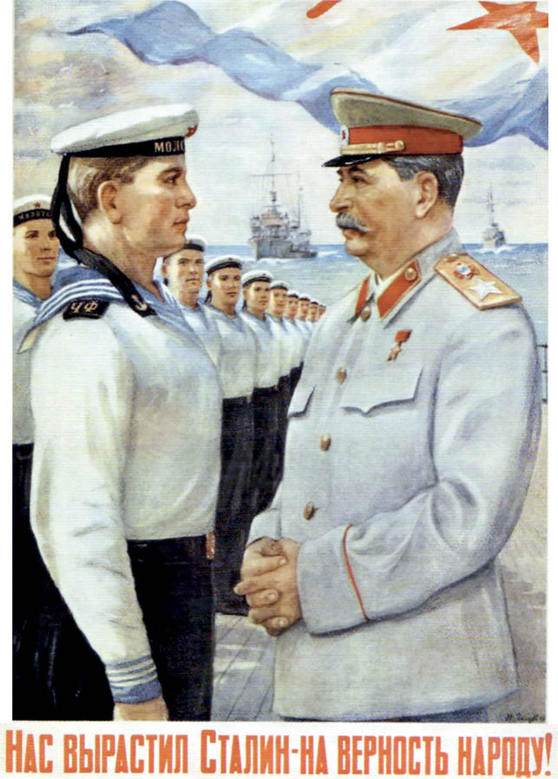
Various Artworks of Stalin and Military
Military, peace, prosperity under Stalin
Used extensively during and after World War II to boost morale
‘Stalin raised us to be loyal to the people!’, Petr Golub, 1948

Slide 15
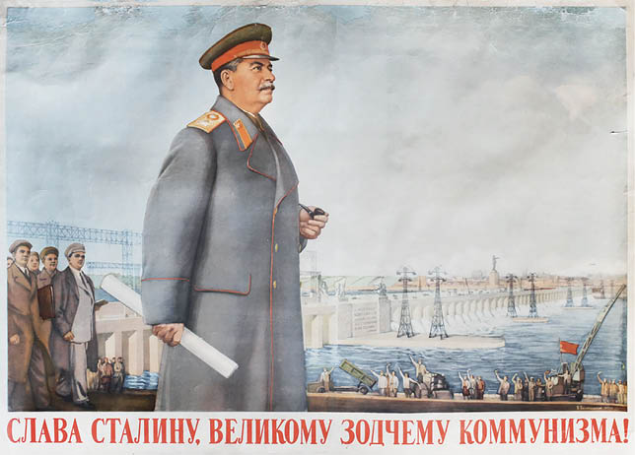
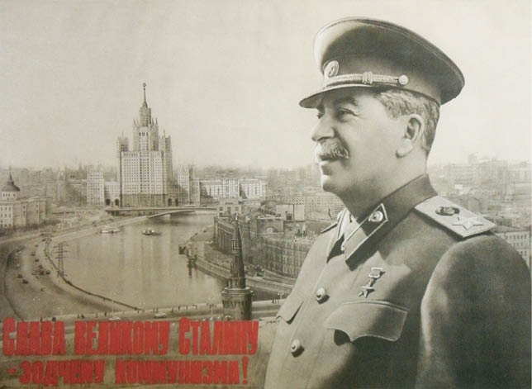
Various Artworks of Stalin and Peace
Propaganda portraits of Stalin of himself and with crowds of people or architecture
Many feature the iconic “arm waving in the air” or pointing meant to garner friendliness, progress and unity
‘Glory to great Stalin, the architect of communism!’, N. Petrov & Konstantin Ivanov, 1952
‘Glory to Stalin, the great architect of communism!’, Boris Belopol’skii, 1951

Slide 16
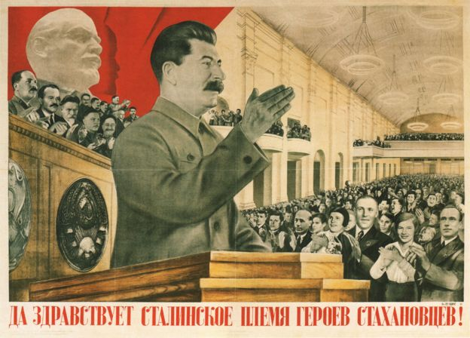
Various Artworks of Stalin and Peace
Propaganda portraits of Stalin of himself and with crowds of people or architecture
Many feature the iconic “arm waving in the air” or pointing meant to garner friendliness, progress and unity
1936 poster, designed by Gustav Klutsis, with the slogan "Long live Stalin´s tribe of Stakhanovite heroes!"

Slide 17
3 Minute Clip: The Fall of Berlin (1950)
Ending of an iconic Soviet War Film that deifies Stalin successfully, made 3 years before his death at the height of his cult of personality.
Arrives in Berlin right after the capture of it in 1945, in a completely out of place and pristine airfield (never happened, completely fictional)
Crowds of Soviet soldiers and prisoners surround and cheer Stalin, who is wearing white and smiling
Even people waving British, American, Hungarian and French flags come to cheer “Long Live Stalin!” and is emphasized in the scene as to show that “everyone loved Stalin”.
Stalin portrayed throughout the movie as kind, cunning and intelligent compared to Churchill, Roosevelt and Hitler as being idiots.

Slide 18

Background of the Emergence of Mao and the Communist Party of China
Rebels overthrew last Chinese emperor in 1912 and established a Republic, Capitalist society under the Kuomintang (Nationalist Party of China).
Aided by Soviet Union until China became more and more right-wing in response to Communism, became aided by United States and Britain after it distanced itself from Soviet Union.
Much of the population satisfied with successful current government, including workers, to the extent in which Mao Zedong had to manipulate and rely on the youth and the poorest peasants to create an army.
Eliminated the KMT leaders and military in Civil War and gained seat of the Chairman in 1949.

Slide 19
Mao Zedong Cult of Personality Propaganda
Huge emphasis on Mao as a symbol, even more than Stalin
“Little Red Book”, Mao’s book of communist manifesto, became a prominent symbol in many artworks
Destruction of the past, and of imperialist, capitalist ideas.
Using youth to carry out agenda, including killing teachers, the elderly and other opposition
Promotion of various social and political campaigns
Huge, iconic emphasis of the Hand wave or arm outstretched, always pointing forward for progress, prosperity.
Very relatable to Stalin propaganda; Father figure, friend, leader, etc.

Slide 20
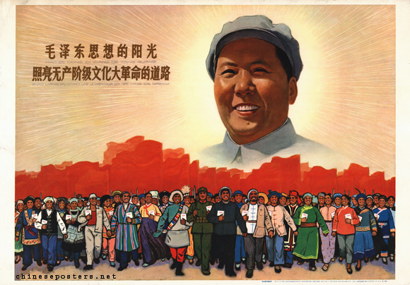
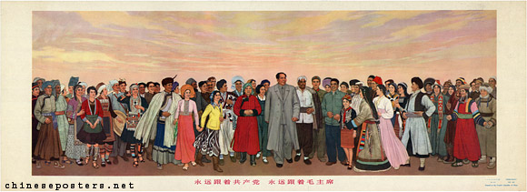
Various Artworks of Mao and National Unity
Promoted unity of the proletariat, peasants, workers, soldiers
“Rising Sun” red beams or rays rising from Mao Zedong
Mao emphasized in the composition
Always expressing revolution and the continuing fight of it
The sunlight of Mao Zedong Thought illuminates the road of the Great Proletarian Cultural Revolution, 1966
Follow the Communist Party forever, follow Chairman Mao forever, early 1970s

Slide 21
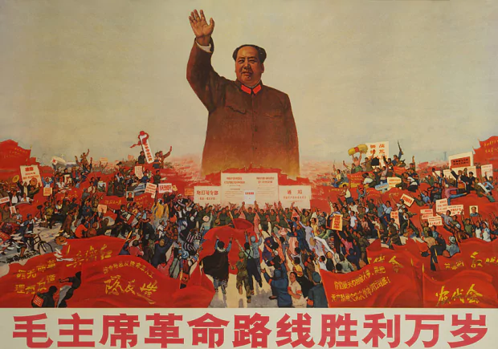
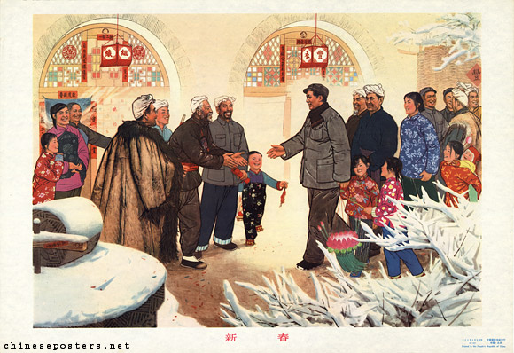
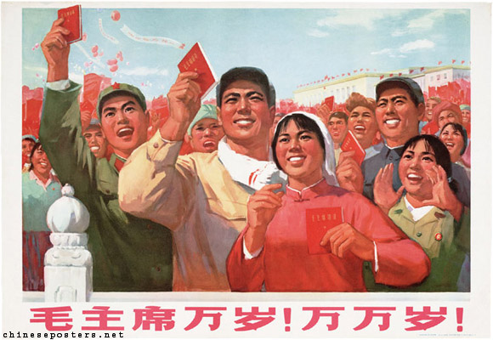
Unknown, 1970
New Spring, early 1970s
Long live chairman Mao! Long, long live!
1970

Slide 22
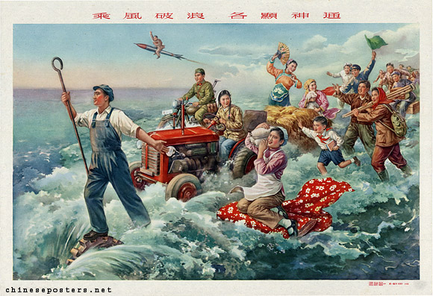
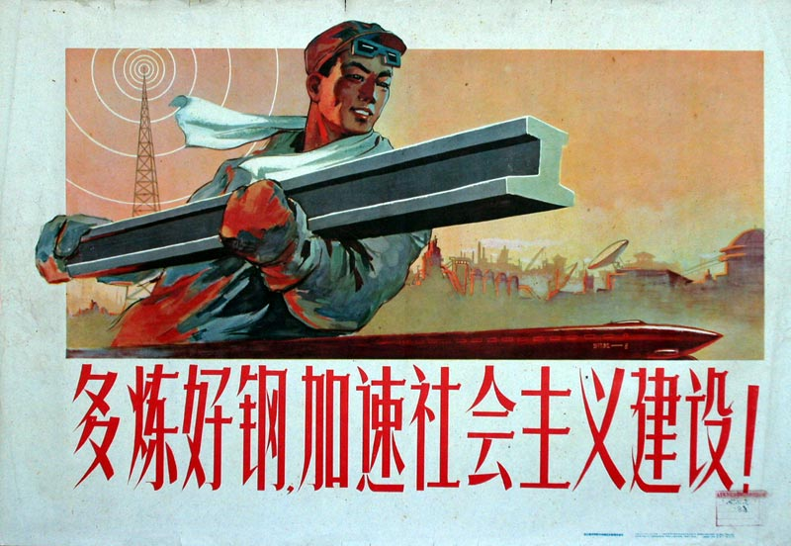
Various Artworks of Mao and Great Leap Forward
Art to promote economic and social campaign to rapidly industrialize and collectivize, punished private farmers
Four Pests Campaign to kill off pests, including sparrows that prevented locust swarms from eating crops
Wasted people resources on creating crude metal and left crops to rot unharvested
Death toll of 55.8 million due to famine
The commune is like a gigantic dragon, production is noticeable awe-inspiring, 1959
Brave the wind and the waves, everything has remarkable abilities, 1959

Slide 23
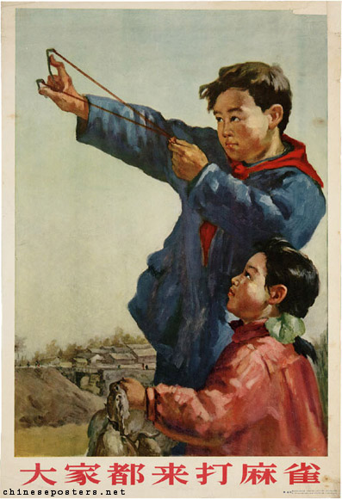
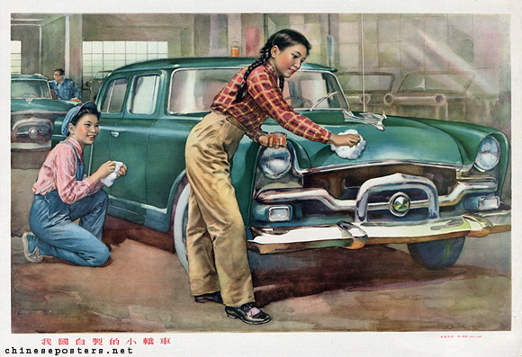
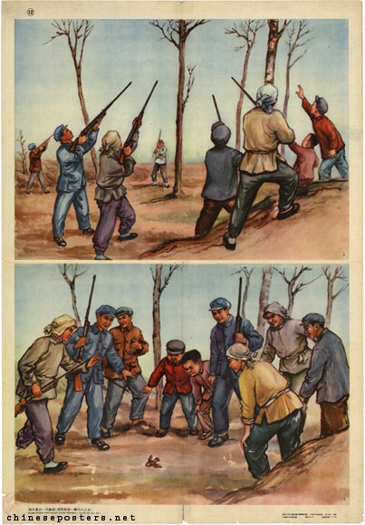
Various Artworks of Mao and Great Leap Forward
A sedan produced by our own country, 1959
Everybody Comes to Beat the Sparrows, 1956
Eliminating the last sparrow, 1959

Slide 24
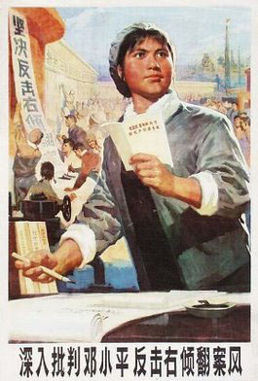
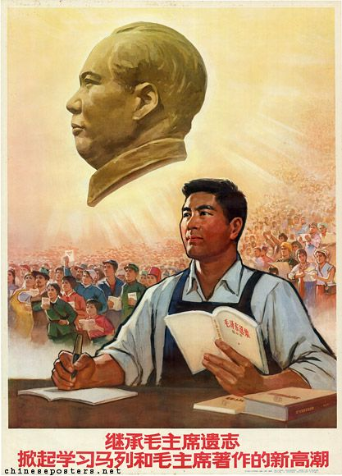
Various Artworks of Mao and Hundred Flowers Campaign
A campaign with Mao offering free expression and criticism of government through letter writing
Overwhelmingly negative criticism
Decides to silence the opposition and send them to prison labor camps

Slide 25
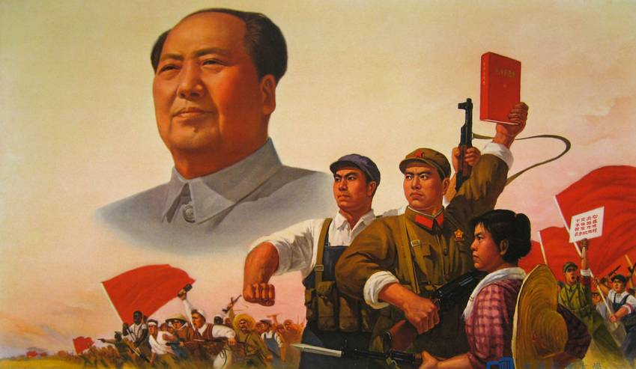
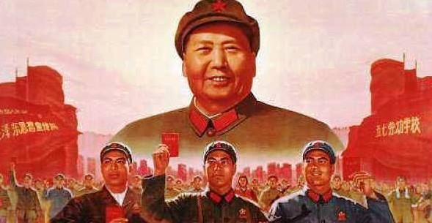
Various Artworks of Mao and Cultural Revolution
A campaign to restore Maos popularity by eliminating or silencing opposition using the youth as the “Red Guard”
Emphasis on Mao and Little Red Book
Destroying the past culture of China that existed for more than 2000 years

Slide 26
2:22 video: Cultural Revolution
A clip of footage from the Cultural Revolution with a Chinese narrator expressing the purpose of it in English.
Shows great amounts of Communist Nationalism.
Youth taking down and destroying the old culture, and anything representative of capitalist society.

Slide 27
Conclusion
Ideology expressed in these artworks is showing what is desired for change
Hegemonic responses expressed promote or influence that ideology or the government or leader
Socialist Realism is the exaggeration of these conditions, deifying normal, mortal people that have too much power and bring an illusion of reality
After their deaths, DeStalinization and DeMaoism took place to give Russians/Chinese better rights to prevent another revolution after their deity passed away.
Stalin and Mao basically denounced.

